Slide 1
Restaurant Startup Analysis
What if you knew it before starting up!!!!?
Varchaleswari Ganugapati
(aka Varchala)
vganugapati1@student.gsu.edu

Slide 2
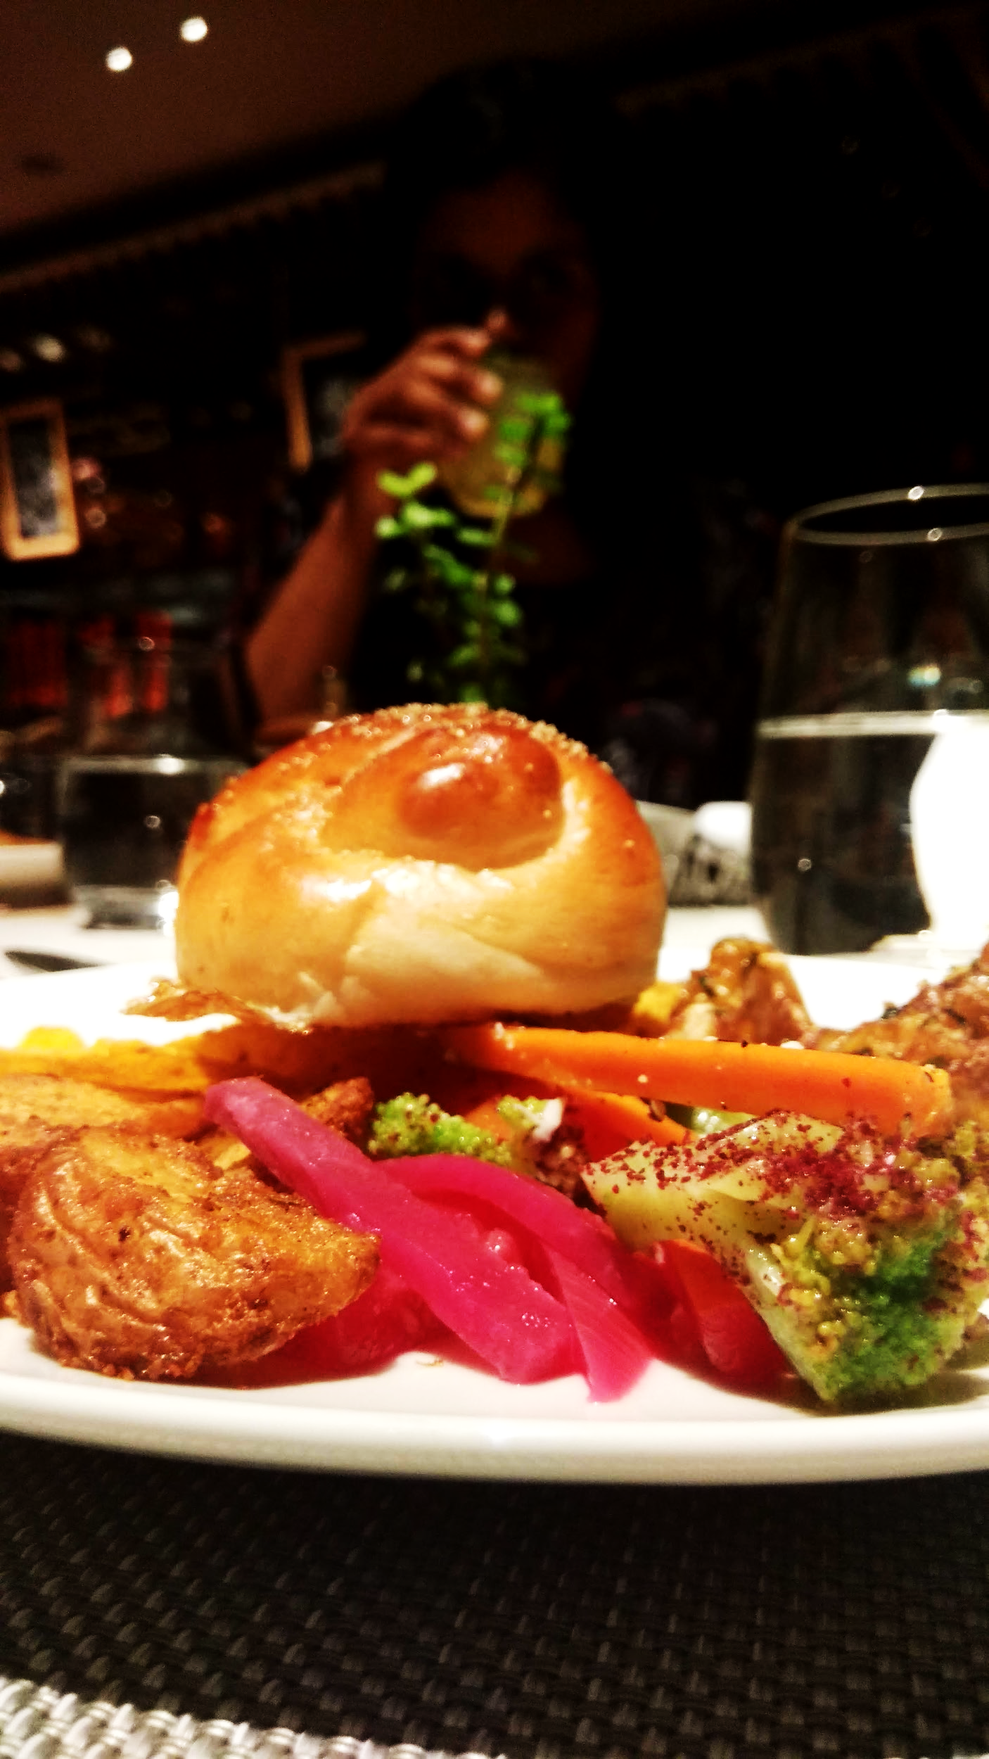
Aim: Analyse one of the most important feature of urban life: food and the entities that bring it to us, using different data mining techniques.

Slide 3
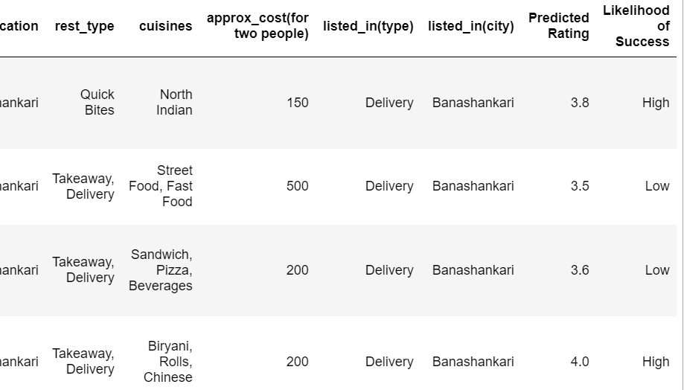
Prediction Example

Slide 4

Source
Zomato Media Pvt. Ltd. is a leading Indian restaurant aggregator and food delivery start-up that provides information on menus and user-reviews for different restaurants across different cities in India.

Slide 5
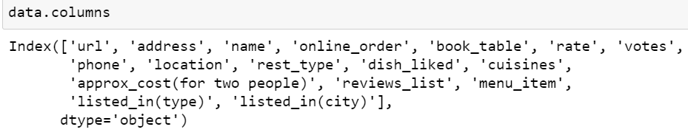
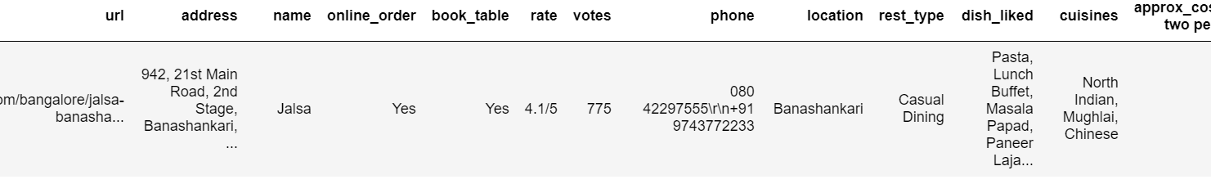
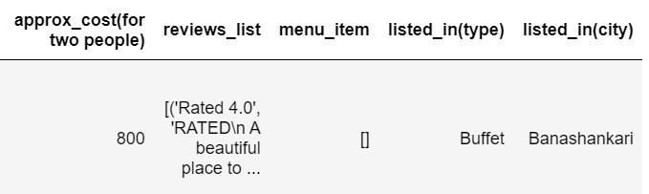
Peek into the raw data

Slide 6
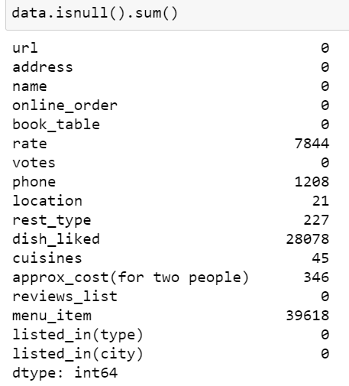
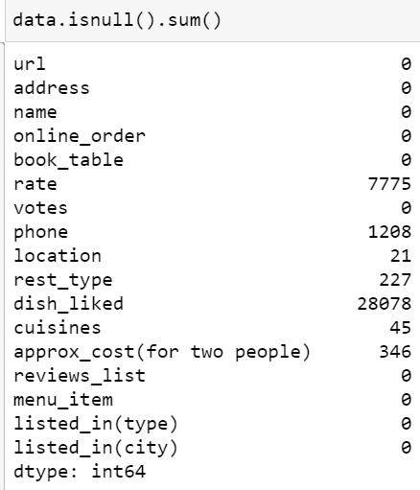
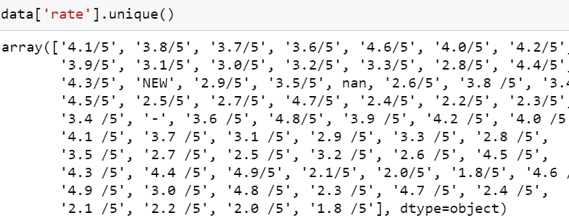
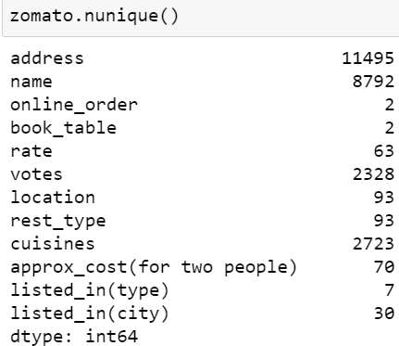
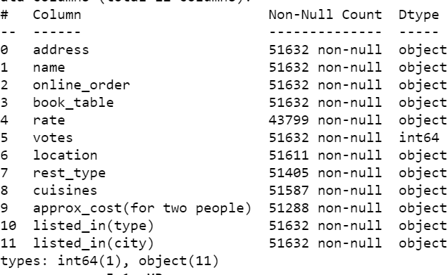
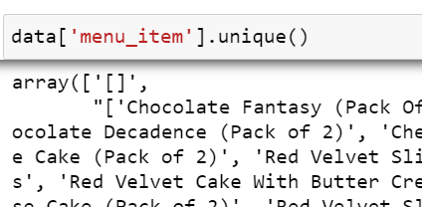
Data Cleaning/Preprocessing

Slide 7
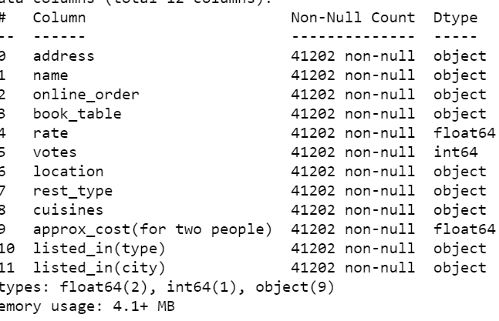
Features
address
name
online_order
book_table
votes
location
rest_type
cuisines
approx_cost(for two people)
listed_in(type)
isted_in(city)
rate

Slide 8
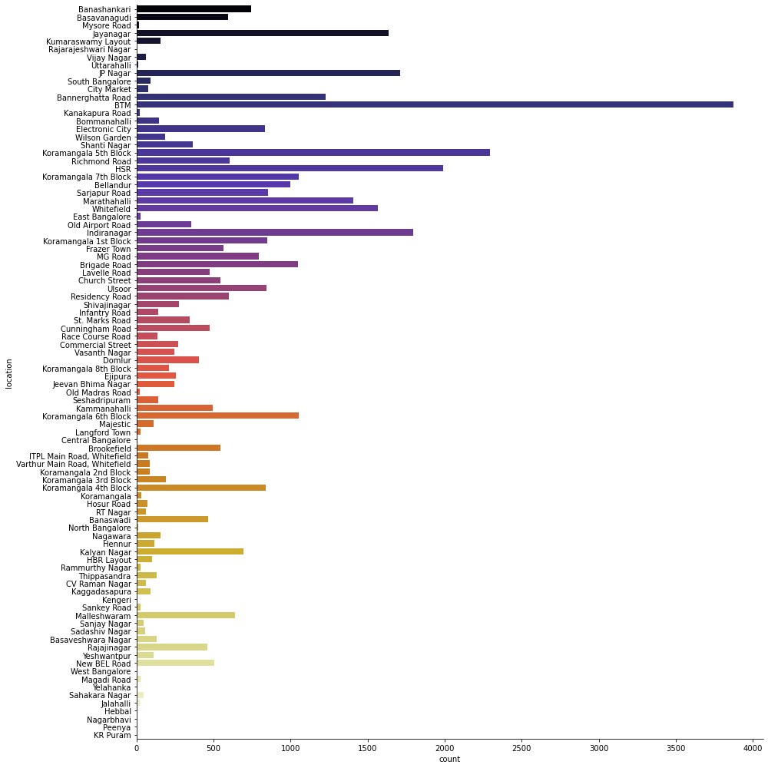
Exploratory Data Analysis

Slide 9
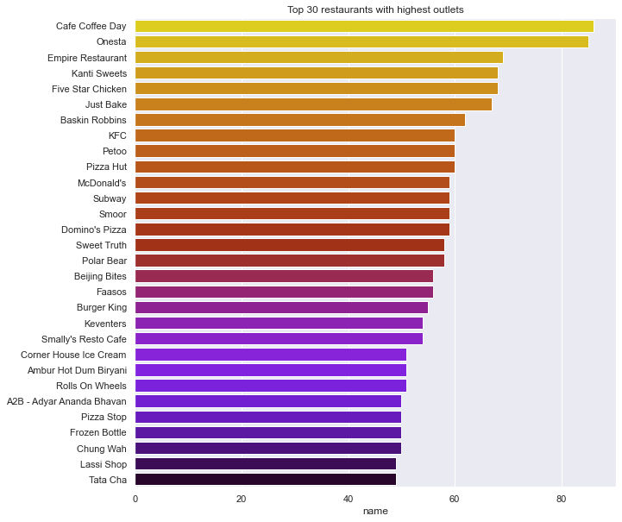
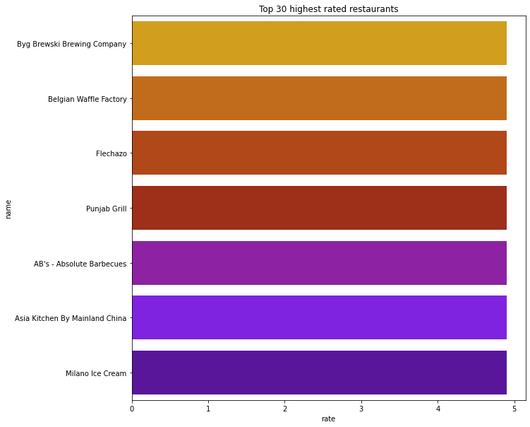
Exploratory Data Analysis

Slide 10
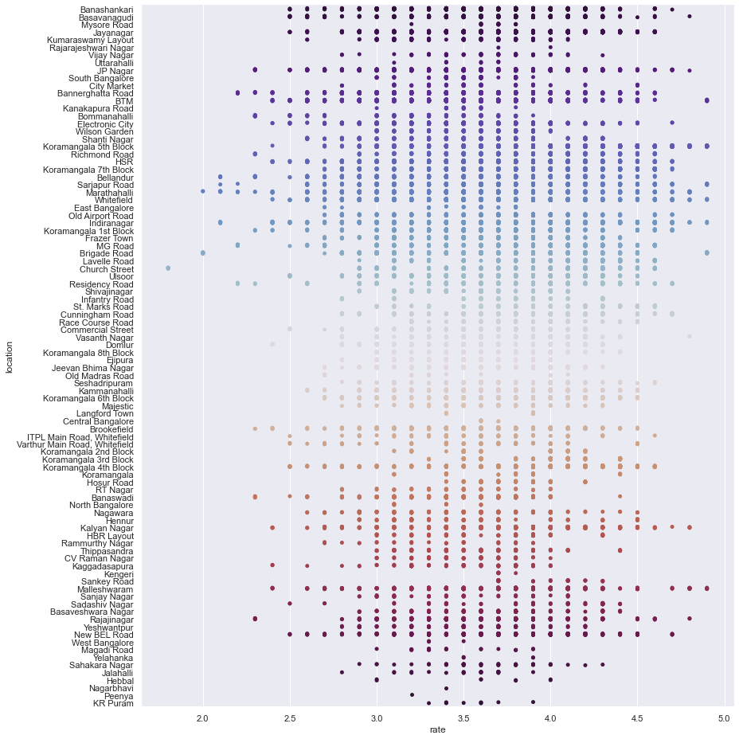
How do rates differ with locations?

Slide 11
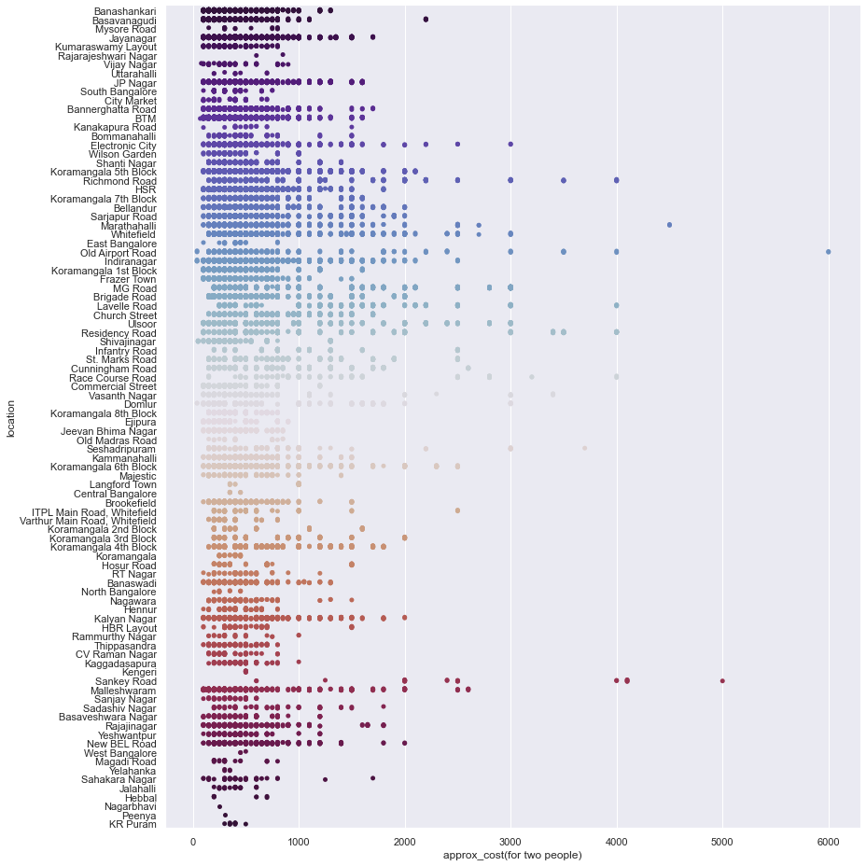
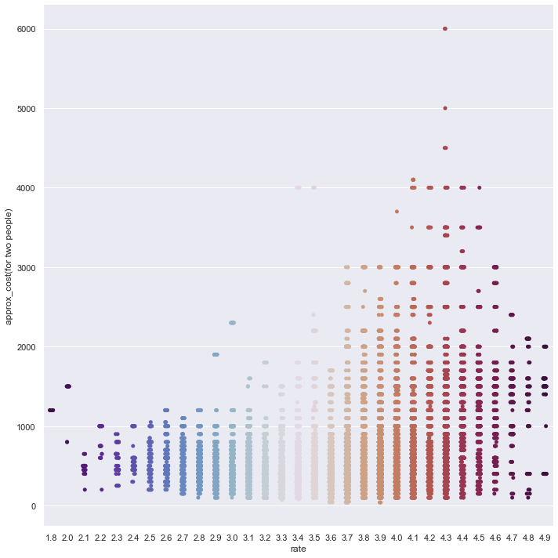

Slide 12
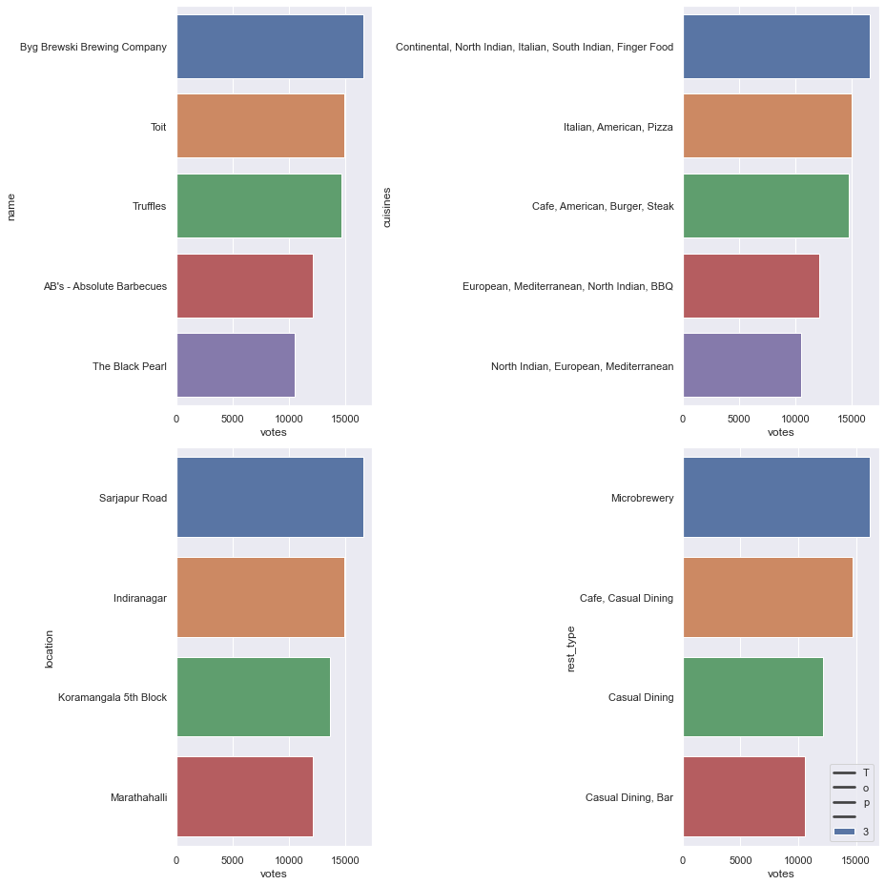
Top 30 restaurants’ total number of people rated vs cuisines,location and restaurant type

Slide 13
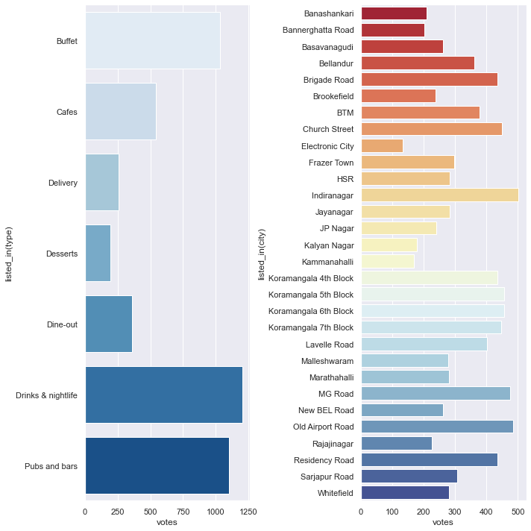

Slide 14
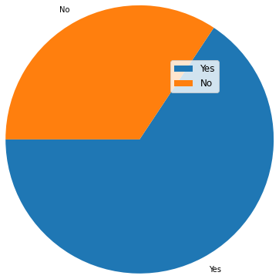
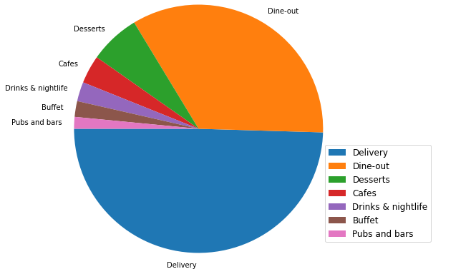
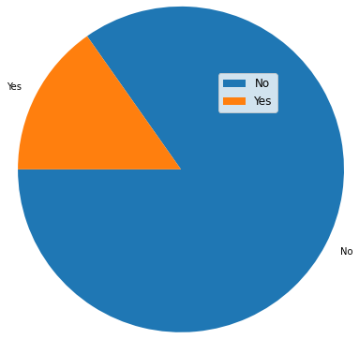
online_order
book_table
listed_in(type)

Slide 15
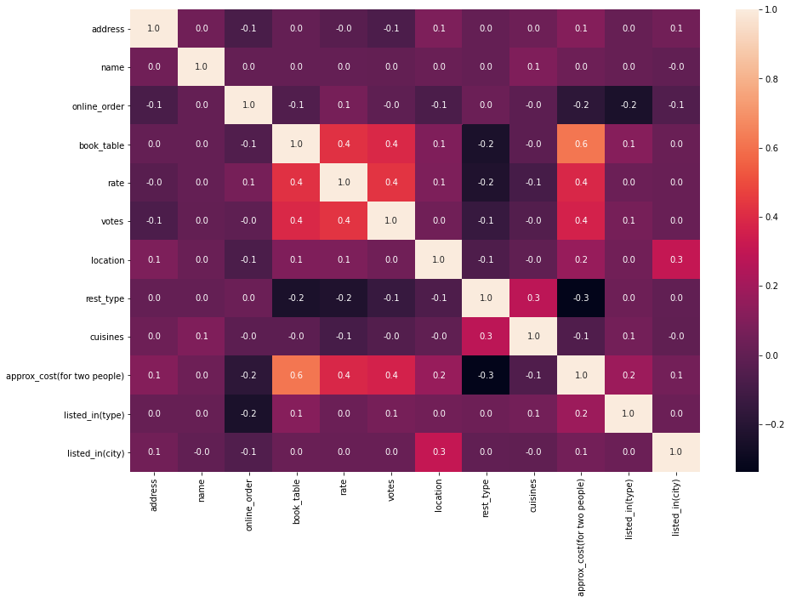
Correlation Graph

Slide 16
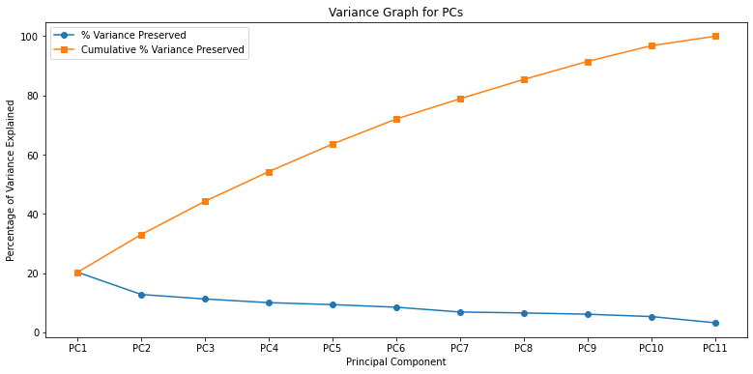
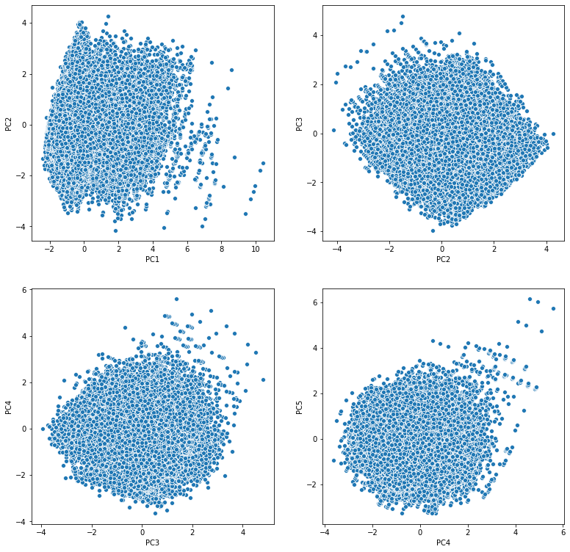
PCA

Slide 17
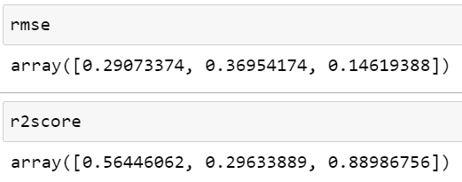
Approaches
Test Score | Random forest with PCs | Linear Regression | Random forest with the original features
R2 Score | 0.58383619, | 0.35219669 | 0.9113043
RMSE | 0.27809065, | 0.34695712, | 0.12806398

Slide 18
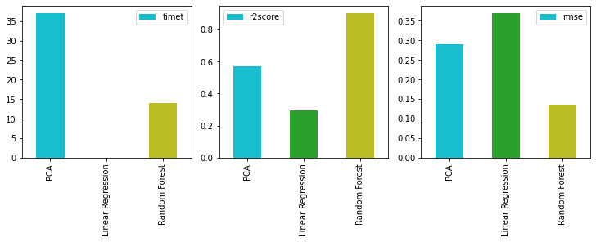
Performance Graph

Slide 19
Performance Graph
Winner

Slide 20
Random forest has been the most suitable for the prediction of the target variable based on the limited set of features that were chosen for the model.
The architecture of the model is designed such that it can be trained for different datasets from different cities across India given the set of features remain the same.
However, to scale the model to higher dimensions requires a rework on evaluating the model using random forest as the algorithm tends to perform poor with an increase in the number of variables beyond certain threshold.
Takeaways

Slide 21
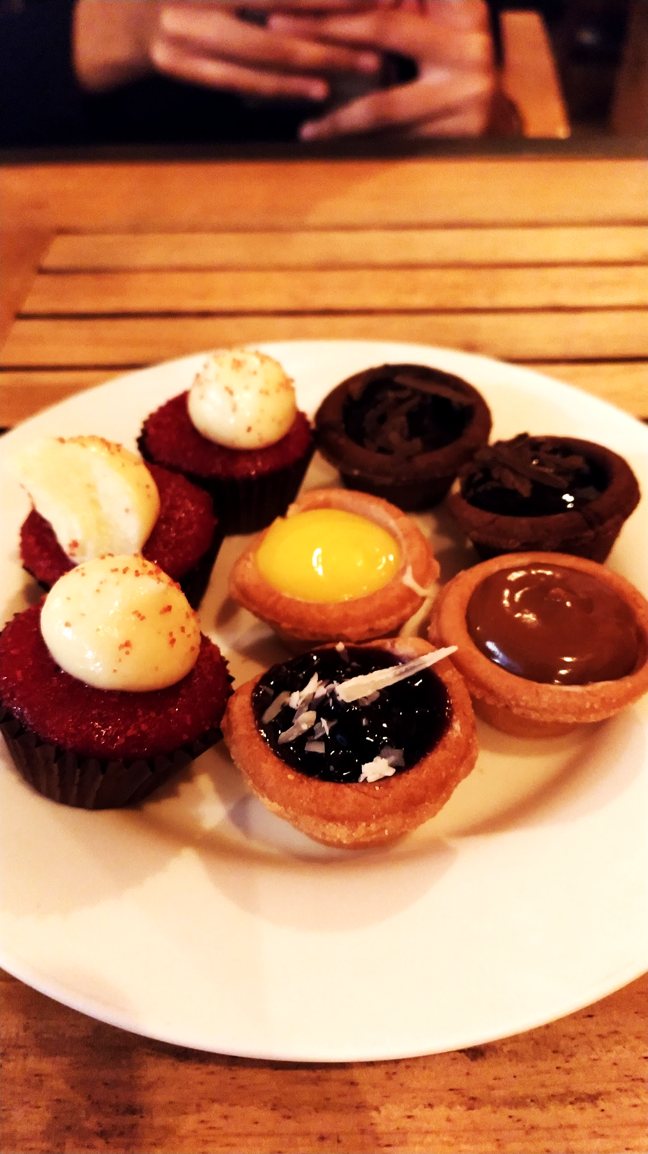
Thanks!
Contact me:
vganugapati1@student.gsu.edu

